Slide 1
Data visualizations in R
Rishi Sai Reddy Sudireddy

Slide 2
Tools to do data visualizations
There are four basic presentation types:
Comparison
Composition
Distribution
Relationship

Slide 3
To determine which amongst these is best suited for your data, I suggest you should answer a few questions
How many variables do you want to show in a single chart?
How many data points will you display for each variable?
Will you display values over a period of time, or among items or groups?

Slide 4
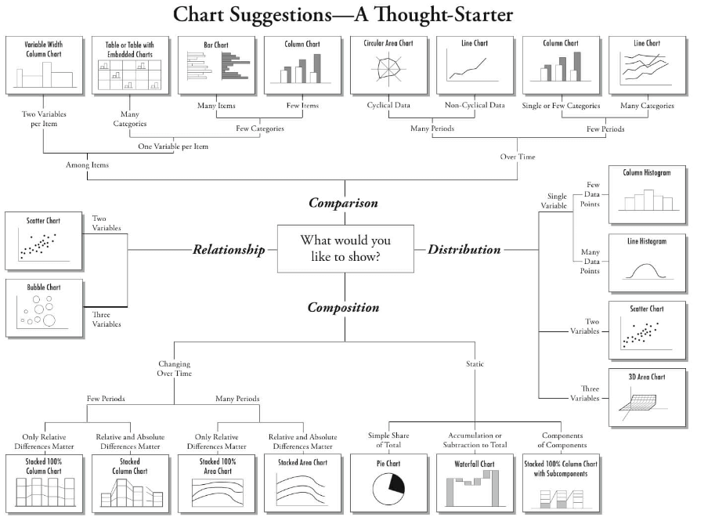

Slide 5
library(ggplot2) ``
ggplot(train, aes(Item_Visibility, Item_MRP)) + geom_point() + scale_x_continuous("Item Visibility", breaks = seq(0,0.35,0.05))+ scale_y_continuous("Item MRP", breaks = seq(0,270,by = 30))+ theme_bw()

Slide 6
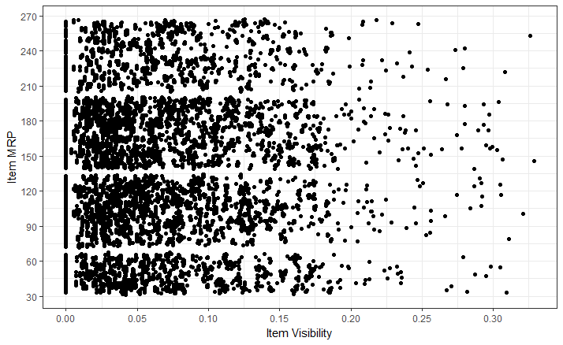

Slide 7
ggplot(train, aes(Item_Visibility, Item_MRP)) + geom_point(aes(color = Item_Type)) +
scale_x_continuous("Item Visibility", breaks = seq(0,0.35,0.05))+
scale_y_continuous("Item MRP", breaks = seq(0,270,by = 30))+
theme_bw() + labs(title="Scatterplot")

Slide 8
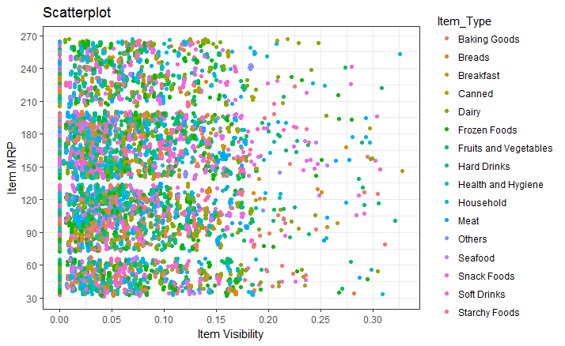

Slide 9
ggplot(train, aes(Item_Visibility, Item_MRP)) + geom_point(aes(color = Item_Type)) + scale_x_continuous("Item Visibility", breaks = seq(0,0.35,0.05))+ scale_y_continuous("Item MRP", breaks = seq(0,270,by = 30))+ theme_bw() + labs(title="Scatterplot") + facet_wrap( ~ Item_Type)

Slide 10
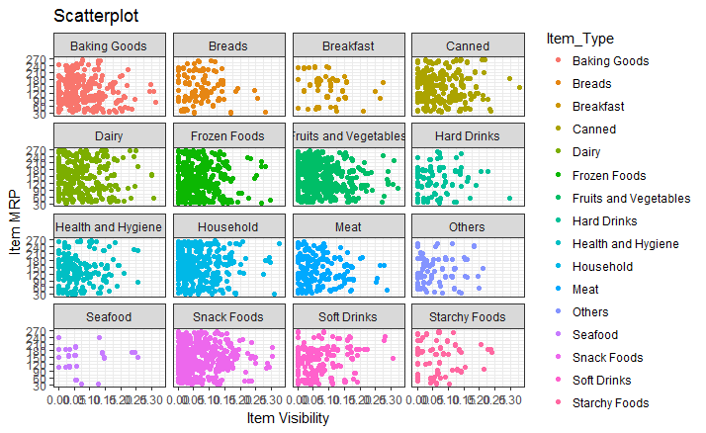

Slide 11
ggplot(train, aes(Item_MRP)) + geom_histogram(binwidth = 2)+
scale_x_continuous("Item MRP", breaks = seq(0,270,by = 30))+
scale_y_continuous("Count", breaks = seq(0,200,by = 20))+
labs(title = "Histogram")

Slide 12
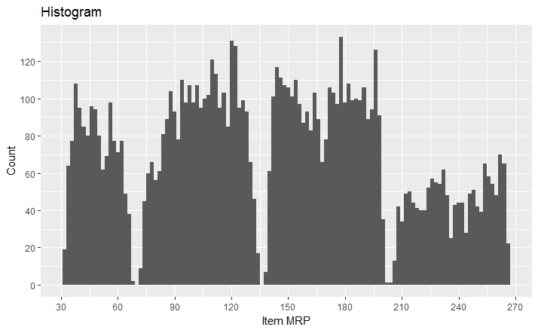

Slide 13
ggplot(train, aes(Outlet_Establishment_Year)) + geom_bar(fill = "red")+theme_bw()+ scale_x_continuous(“Count", breaks = seq(1985,2010)) + scale_y_continuous(“Establishment_Year", breaks = seq(0,1500,150)) + coord_flip()+ labs(title = "Bar Chart") + theme_gray()

Slide 14
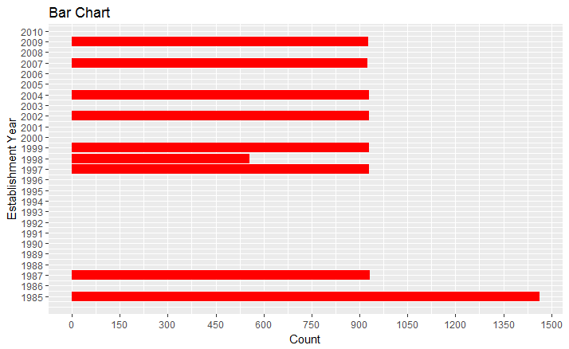

Slide 15
ggplot(train, aes(Item_Type, Item_Weight)) + geom_bar(stat = "identity", fill = "darkblue") + scale_x_discrete("Outlet Type")+ scale_y_continuous("Item Weight", breaks = seq(0,15000, by = 500))+ theme(axis.text.x = element_text(angle = 90, vjust = 0.5)) + labs(title = "Bar Chart“)

Slide 16
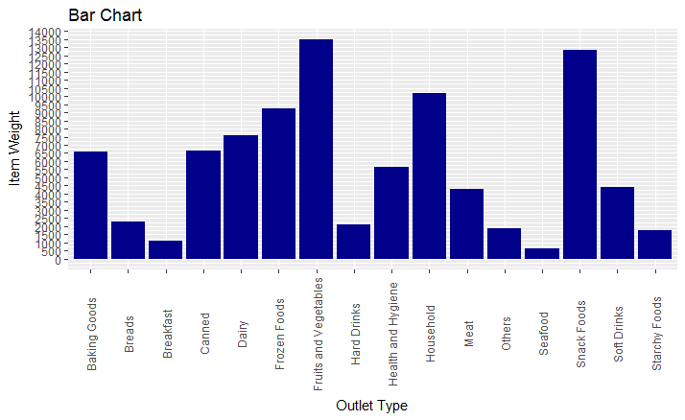

Slide 17
Stacked bar chart
ggplot(train, aes(Outlet_Location_Type, fill = Outlet_Type)) + geom_bar()+labs(title = "Stacked Bar Chart", x = "Outlet Location Type", y = "Count of Outlets")

Slide 18
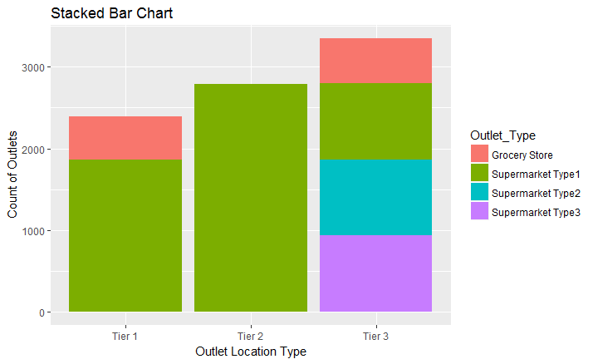

Slide 19
ggplot(train, aes(Outlet_Identifier, Item_Outlet_Sales)) + geom_boxplot(fill = "red")+scale_y_continuous("Item Outlet Sales", breaks= seq(0,15000, by=500))+labs(title = "Box Plot", x = "Outlet Identifier")

Slide 20
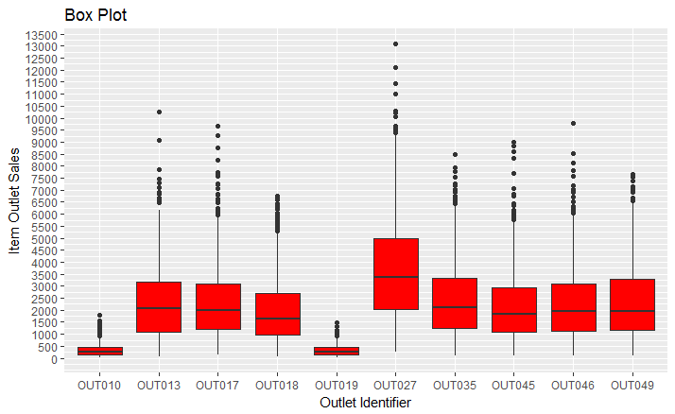

Slide 21
ggplot(train, aes(Item_Outlet_Sales)) + geom_area(stat = "bin", bins = 30, fill = "steelblue") + scale_x_continuous(breaks = seq(0,11000,1000))+ labs(title = "Area Chart", x = "Item Outlet Sales", y = "Count")

Slide 22
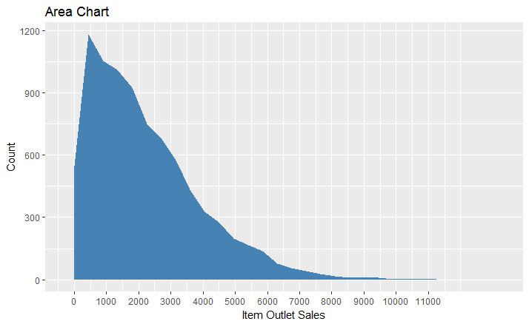

Slide 23
ggplot(train, aes(Outlet_Identifier, Item_Type))+ geom_raster(aes(fill = Item_MRP))+ labs(title ="Heat Map", x = "Outlet Identifier", y = "Item Type")+ scale_fill_continuous(name = "Item MRP")

Slide 24
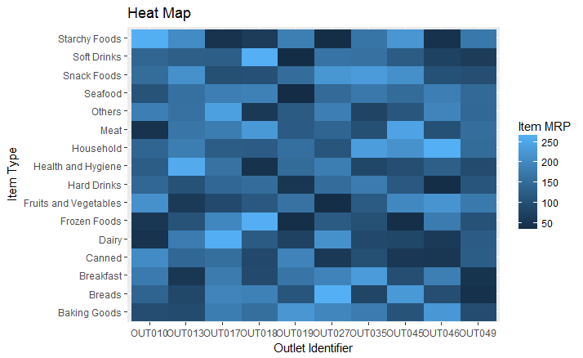

Slide 25
install.packages("corrgram")library(corrgram)
corrgram(train, order=NULL, panel=panel.shade, text.panel=panel.txt, main="Correlogram")

Slide 26
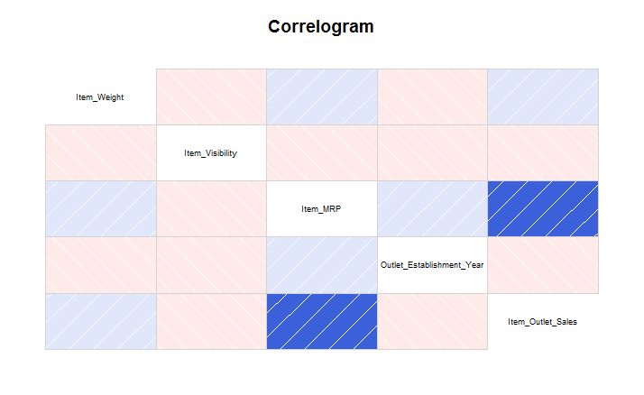

Slide 27
Getting started : ui.r and server.r
install.packages(“shiny”)
Create user interface in ui.R file,
Create the server.R file for computation purpose,

Slide 28
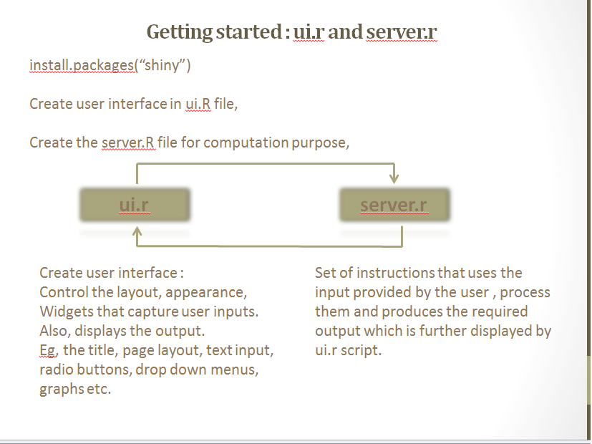

Slide 29
Structure of ui.r
library(shiny) # Remember to load the shiny package
# Define UI for the shiny application here.
shinyUI(fluidPage(
# Application title
titlePanel(),
# sidebarLayout(
# Sidebar panel
sidebarPanel(),
# Main Panel
mainPanel()
)
)
)

Slide 30
Structure of server.r
library(shiny)
shinyServer(
function(input, output) {
}
)

Slide 31
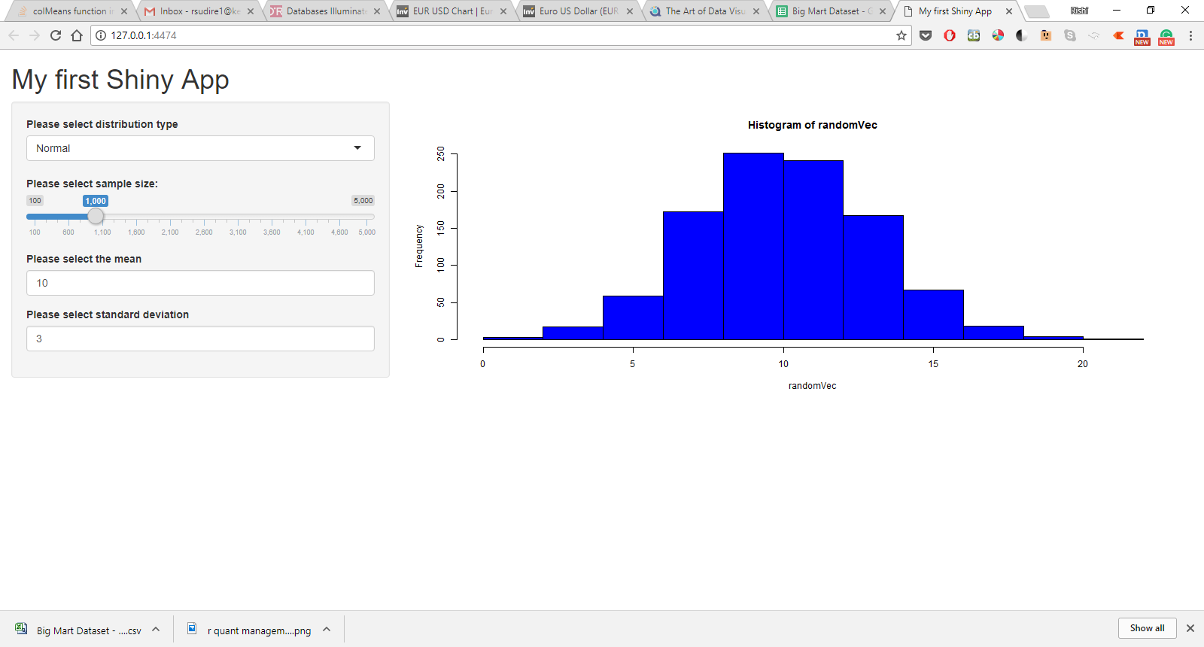
Shiny - R

Slide 32
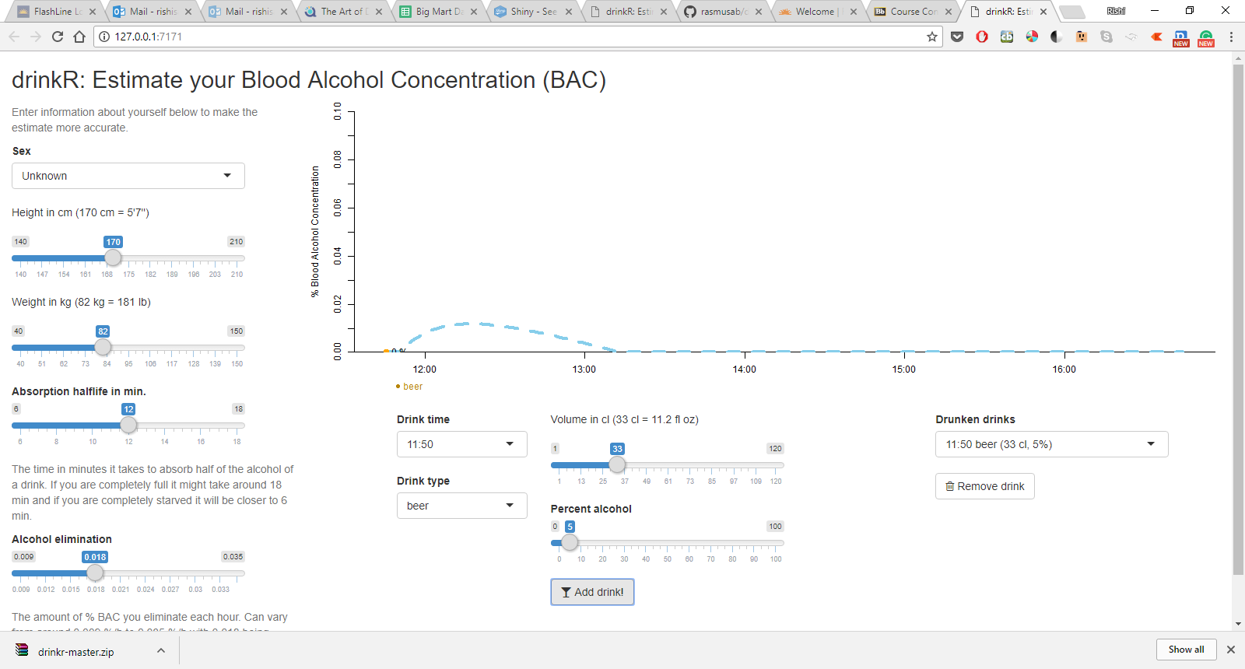
Time estimate to get out of high*

Slide 33
Thank You!

